Slide 2
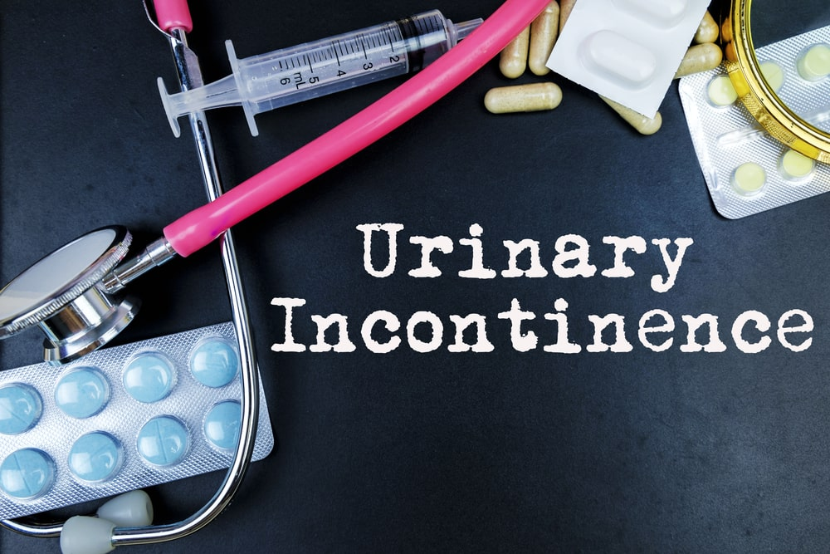
URINARY INCONTINENCE
Ass. Prof. Dr. Sawsan Talib
Department of Obstetrics and Gynecology College of medicine/ Diyala University
Lec 4 /5th stage /2021-2022

Slide 3
Urinary incontinence is defined as involuntary loss of urine which is objectively demonstratable and socially embarrassing .
The prevalence increases with age, with approximately 5 per cent of women between 15 and 44 years of age being affected, rising to 10 per cent of those aged between 45 and 64 years, and approximately 20 per cent of those older than 65 years.

Slide 4
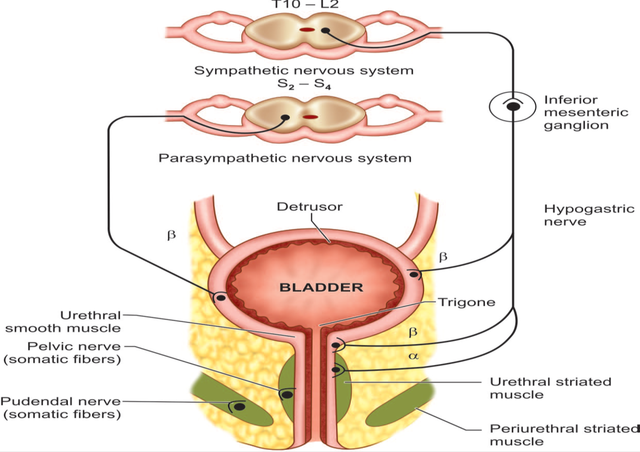
Factors which maintain continence in females
There are three factors which contribute to female continence as such
Detrusor muscle; the wall of the bladder is surrounded by the detrusor muscle which is composed of smooth involuntary fibers. Sympathetic system causes inhibition of this muscle while parasympathetic system causes its contraction.
Sphincter urethrae muscle; composed of inner involuntary smooth muscle fibers. While the outer part is composed of striated muscle fibers. The parasympathetic system causes its relaxation while the sympathetic system promotes its contraction.
The proximal part of the urethra; in normal continent women the proximal part of the urethra is usually above the levator ani. In other words it is an intra abdominal organ. Descent of this portion bellows the levator ani muscle cause loss of continence. The most common cause is genital tract prolapse

Slide 5
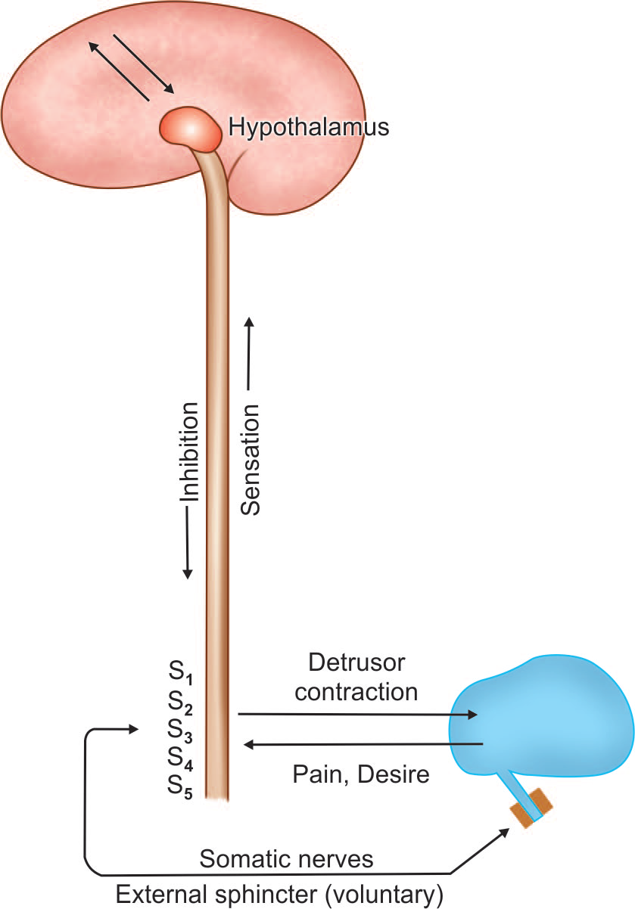
Nervous control of bladder filling and emptying

Slide 6
Types of urinary incontinence:
Stress urinary incontinence SUI (Urodynamic)
Urge incontinence ( Detrusor over activity) DOA
Mixed incontinence ( SUI + DOA)
Bypass incontinence ( fistula or cong. Abnormality)
Functional incontinence, especially in elderly (DIAPERS) , may be transient. :
D: Dementia / Depression
I: Infection
A: Atrophy
P: Pharmacological drugs
E: Endocrine (DM)
R: Restricted mobility
S: Stool impaction

Slide 7
GENUINE STRESS INCONTINENCE (GSI)
It is involuntary urethral loss of urine when the intravesical pressure exceeds the maximum urethral pressure in the absence of detrusor activity.
The diagnosis of GSI should be made following urodynamic assessment only.
Incidence: The reported incidence in the Western countries is as high as 40 percent in association with prolapse. In about 5 percent, the symptoms may be annoying.

Slide 8
Pathophysiology
In most cases is due to hypermobility, where the pelvic floor and ligaments cannot retain the urethra in position during increases in abdominal pressure, leading to leakage of urine .
Intrinsic sphincter deficiency (ISD) is due to weakness of the sphincter muscles , which is associated with:
Obstetric factors ( history of vaginal childbirth).
Non-obstetric factors.

Slide 9
• Damage to the nerve supply of the pelvic floor and urethral sphincter caused by childbirth leads to progressive changes in these structures, result in altered function. In addition, mechanical trauma to the pelvic floor musculature an endopelvic fascia and ligaments occurs as a consequence of vaginal delivery. Prolonged second stage, large babies and instrumental deliveries cause the most damage.
• Menopause Estrogen deficiency leads to atrophy of the supporting structures along with diminished periurethral vascular resistance
• A congenital cause may be inferred, as some nulliparous women suffer from incontinence. This may be due to altered connective tissue, particularly collagen. Stress incontinenc is much less common in black women and differences in connective tissue are thought to be responsible.
• Chronic causes, such as obesity and chronic obstructive pulmonary disease, raise intra-abdominal pressure, and constipation an associated straining may also result in problems

Slide 10
(A) Normally any increase in intra-abdominal pressure compresses the upper urethra. (B) If the bladder neck descends, this does not occur

Slide 11
Risk factors for stress urinary incontinence
Multiparity (vaginal births).
Forceps delivery.
Perineal trauma.
Long labour.
Epidural analgesia.
Birthweight >4 kg.
Increasing age.
Postmenopause.
Obesity.
Connective tissue disease.
Chronic cough (e.g. bronchiectasis or chronic obstructive pulmonary disease).
Doxazocin(alpha-adrenergic antagonist) for hypertension causes relaxation of the urethral sphincter.

Slide 12
Symptoms of stress incontinence
The only symptom is escape of urine with coughing, sneezing or laughing. The loss of urine has got the following features:
 Brief and coincides precisely to the period of raised intra-abdominal pressure.
 Unassociated with a desire to pass urine.
 Rarely, occurs in supine position or during sleep.
 Patients are fully aware of it.
 The amount of loss is small.

Slide 13
Diagnosis
Details of medical history (e.g. diabetes, chronic pulmonary disease, neurological disease),
surgical history (spine or genitourinary tract),
Current medications (sedatives, antipsychotics) must be noted. Because these have direct bearing on urinary
incontinence.
Record the severity, including:
The number of episodes / day.
Whether continence pads are needed, and its size.
Whether the patient needs to change her underclothes or outer clothes because of leakage.
What behaviour changes ( reduced their fluid intake and may limit their social activities).

Slide 14
Physical examination
On clinical examination, stress incontinence may be demonstrated when the patient coughs
Vaginal examination should assess for prolapse and, in particular, the vaginal capacity and the woman’s ability to elevate the bladder neck, as this may alter management.
Local- excoriation of vulval skin.
Atrophic changes, cystocele, prolapse.
Bladder neck elevation test(Marchetti test)- To see whether surgery will benefit or not.
Mental state, developmental anomalies, neurological examination

Slide 15
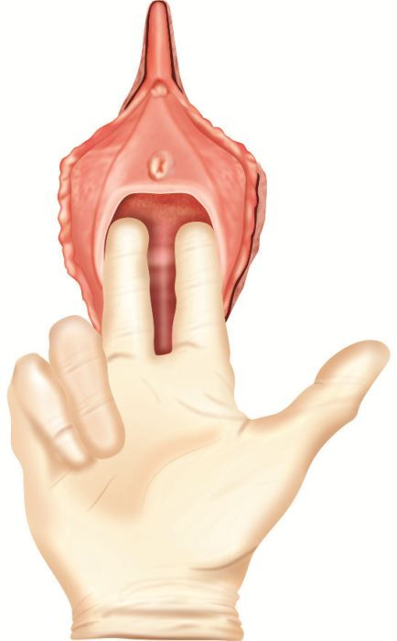
Bonney's test
The patient is asked to insert 2 fingers in periurethral region causing lifting of the bladder neck and then the patient is asked to cough.
If SUI gets corrected , then it is due to bladder neck decent.
If SUI persist , it is due to sphincter defect
Q tip test
A sterile cotton swab is introduced into the level of bladder neck.
The patient is asked to strain
Marked upward elevation of cotton tip > 30 ⁰ Indicate urethra hyper mobility

Slide 16
Investigations
General practitioner/outpatient
Mid-stream specimen of urine
Frequency/volume chart
Pad test
Basic urodynamics
Uroflowmetry
Cystometry
Videocystourethrography
Specialized
Urethral pressure profilometry
Cystourethroscopy
Ultrasound
Cystourethrography
Intravenous urography
Electromyography
Ambulatory urodynamics

Slide 17
Urinary diary
A urinary diary is a simple record of the patient’s fluid intake and output (Figure 16.3). Episodes of urgency and leakage and precipitating events are also recorded
There is no recommended period for diary keeping;
a suggested practice is 3–5 consecutive days
Pad tast
Pad tests are used to verify and quantify urine loss.
The International Continence Society pad test takes 1
hour. The patient wears a pre-weighed sanitary towel,
drinks 500 mL of water and rests for 15 minutes. After
a series of defined manoeuvres, the pad is reweighed;
a urine loss of more than 1 g is considered significant.

Slide 18
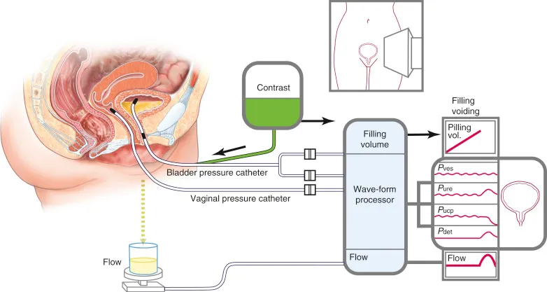
Cystometry
Cystometry is simply evaluation of the bladder volume- pressure relationship.
In clinical cystometry the bladder is repeatedly filled with fixed amount of normal saline. After full inflation the women is asked to pass urine and the intra vesical pressure is measured.
.

Slide 19
Cystometry is indicated for the following:
Previous unsuccessful continence surgery.
Multiple symptoms, i.e. urge incontinence, stress incontinence and frequency.
Voiding disorder.
Neurogenic bladder.
Prior to primary continence surgery: this is still debatable if stress incontinence is the only symptom
The following are parameters of normal bladder function
• Residual urine of <50 mL.
• First desire to void between 150 and 200 mL.
• Capacity between 400 and 600 mL.
• Detrusor pressure rise of <15 cmH2O during filling and standing.
• Absence of systolic detrusor contractions.
• No leakage on coughing.
• A voiding detrusor pressure rise of <70 cmH2O with a peak flow rate of >15 mL/second for volume >150 mL.

Slide 20
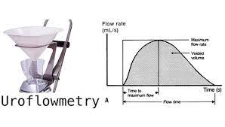
Uroflowmetry
Uroflowmetry is the measurement of urine flow rate and is a simple, non-invasive procedure that can be performed in the outpatient department
The main indications
are complaints of hesitancy or difficulty voiding in
patients with neuropathy or a past history of urinary
retention. It is also indicated prior to bladder neck
or radical pelvic cancer surgery to exclude voiding
problems that may deteriorate afterwards.
***The normal flow curve is bell shaped. A flow
rate <15 mL/second on more than one occasion is
considered abnormal in females . The voided volume
should be >150 mL, as flow rates with smaller volumes
are not reliable

Slide 21
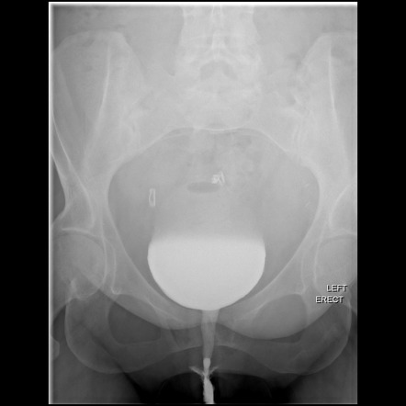
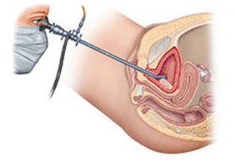
Videocystourethrography
If a radio-opaque filling medium is used during cystometry, the lower urinary tract can be visualized by x-ray screening with an image intensifier
Cystourethroscopy
establishes the presence of disease in the urethra or bladder.
There are few indications in women with incontinence:
• Reduced bladder capacity.
• Short history (less than two years) of urgency and frequency.
• Suspected urethrovaginal or vesicovaginal fistula.
• Haematuria or abnormal cytology.
• Persistent urinary tract infection.

Slide 22
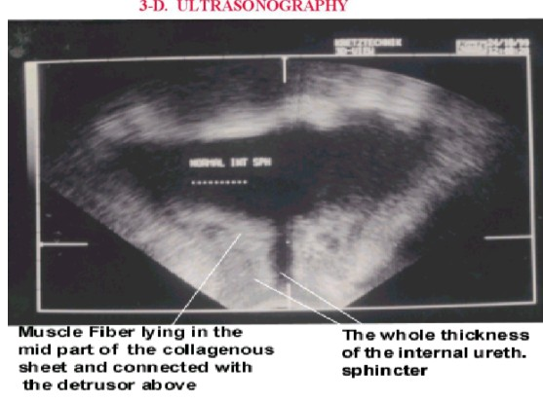
Perineal U/S for bladder neck

Slide 23
Management of GSI
Conservative
Kegel’s exercises of pelvic floor muscles.
Wt. Reduction in obese patients.
Treat chronic cough, UTI.
Faradism- interrupted current to stimulate muscles & nerves.
Drugs- Estrogen, α adrenergic agonists-phenylpropanolamine

Slide 24
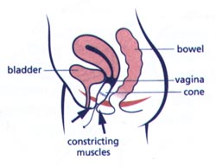
Graduated vaginal cones
Vaginal cones are usually supplied
as four pieces which are similar in
size but different in weight.
First the woman should be able to hold the inserted cone for at least 15 minutes. Then she is asked to use next heavier cone. The aim is strengthen the pelvic floor muscles. And this is usually associated with gradual improvement of mild GSL over 6- 12 months. Mostly this procedure is used to treat mild GSI following vaginal delivery in young women.

Slide 25
Electrical nerve stimulation
In this procedure the levatoe ani is stimulated with a variety of direct or alternating current. Electrical nerve stimulation increases the number of synapse with the nerve fibers. Electrical stimulation is primarily used to treat mild GSI following vaginal delivery.

Slide 26
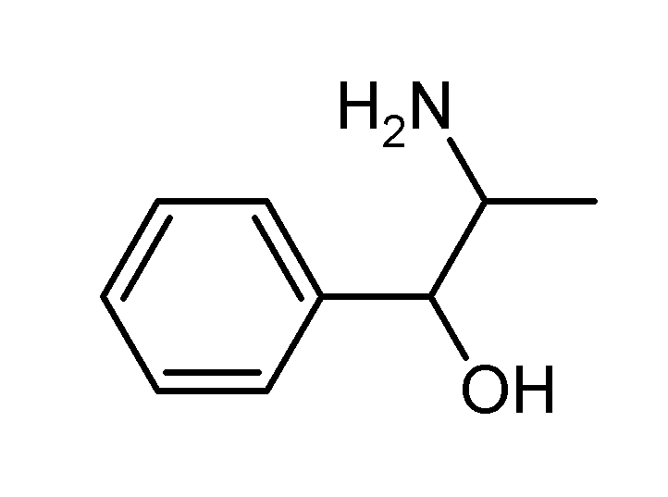
Phenyl propanolamone

Slide 27
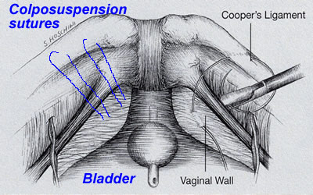
Surgical
all the surgical operations aim at one goal;restoring the proximal urethra into the intra abdominal position. In other words; aiming to elevate the bladder base. The most commonly used operations nowadays include the followings
.
Burch colpo suspension
In this operation the Para urethral tissues are ligated to the ipsi lateral ilio pectineal ligament so to elevate the bladder base.

Slide 28
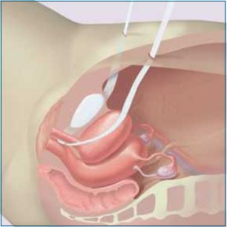
Trans vaginal tape TVT
In this operation a synthetic inert tape is passed bellow the urethra and attached to the anterior abdominal; wall. Remote complications include urethra injury, stricture and retention of urine

Slide 29
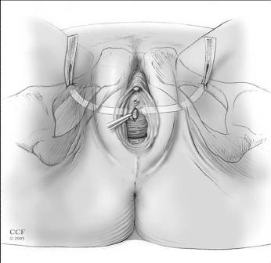
Trans obturator tape or TOT
In this operation a tape is still passed bellow the urethra, however it is passed through the lower part of obturator membrane into the medial aspect of thigh. It requires special needle. This operation is most widely used nowadays to combat GSI. Also has the highest rate of remission.

Slide 30
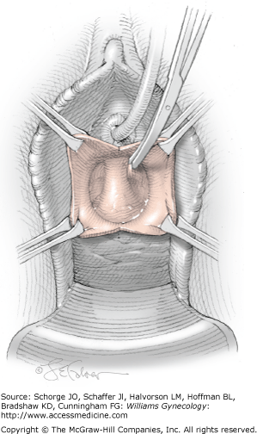
Anterior colporaphy
The same operation for cystocele can elevate bladder neck with restoration of continence

Slide 31
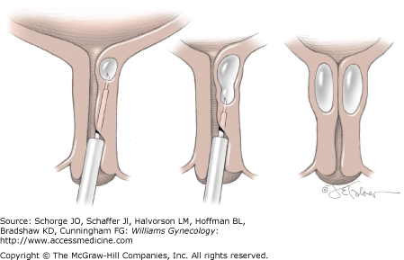
Injection of collagen at bladder base

Slide 32
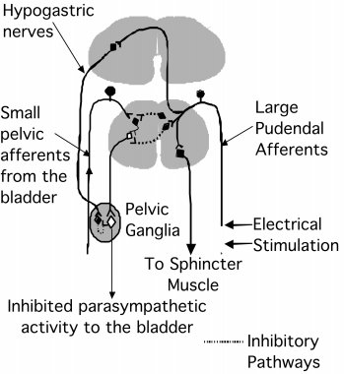
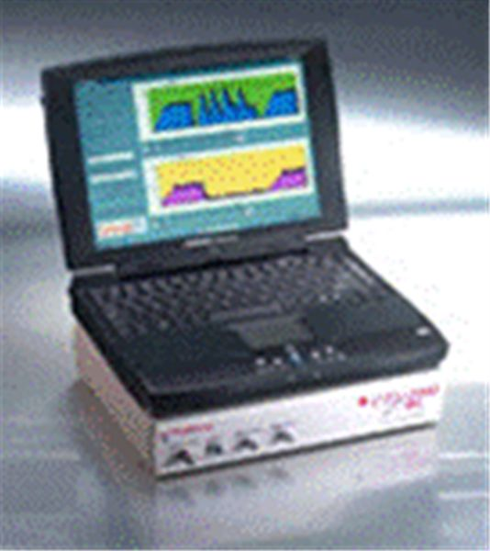
Vaginal electrical stimulation

Slide 33
Detrusor overactivity
Definition
This is primarily a disease of unknown cause in which the bladder contracts strongly to expel the minimum amount of urine which is normally tolerated by normal balder.
Sometime this disorder is called bladder neurosis.
Etiology
Despite the fact in most of the cases physical examination reveals nothing; psychological factors are important in its etiology. Most of those women are psychologically unstable or have deep problems like depression, death phobia, and cancer phobia. In few cases bladder hyper reflexia may be the earliest sigh of multiple sclerosis. And that is why meticulous search should be done exclude this serious disorder before truly diagnosing detrusor instability.

Slide 34
Clinical presentation
Urgency and urge incontinence are the main presentations of this disorder. Ultimately the woman becomes depressed and afraid from getting outside.
Investigations
General urine examination
GUE with mid stream urine for culture and sensitivity is mandatory to find and treat before diagnosis of bladder instability is reached. Most infections of urinary tract are also associated with frequency and urgency.
Bladder cystometry
Bladder cystometry is mostly required to confirm the diagnosis of bladder hyper eflexia. The characteristics in second column in table shown above represent the criteria to confirm the diagnosis.

Slide 35
Interpretation of cystometry
Detruser instability | GSI
First volume bladder filling is < 150 cc | First volume bladder filling is > 150- 250 cc
Maximum bladder capacity is < 200 cm water | Maximum bladder capacity is 500- 600 cm water
Resting intra vesical pressure is > 15 cm water | Resting intra vesical pressure is < 15 cm water
Maximum voiding pressure is >50 cm water | Maximum voiding pressure is < 50 cm water

Slide 36
Treatment of bladder hyper reflexia or detrusor instability
Unlike GSI the treatment of bladder hyper reflexia is usually by medical agents. Any of the followings may be used
Imipramine
Imipramine is tricyclic anti depressant drug which has also anti cholinergic properties. In a dose of 25 mg for 3 months up to 90 % of women get improvement
Terodiline
This calcium channel blocker has specific affinity to bladder detrusor muscle. It is much more effective than imipramine, however it is more expensive.
Oxybutynin
Oxybutynin is anti cholinergic drug which has special affinity to the detrusor muscle. It is much superior to imipramine though it it is ore expensive.
Desmopressin
This vaso pressin analogue acts on the renal tubules to re absorb water. Thus significantly reduce the urinary execration. However its use is associated with significant risk of water intoxication.

Slide 37
Mirabegron:
Is a more recently developed medication for OAB.
Is a beta 3-adrenergic agonist.
Enhance relaxation of the detrusor( acting more on the storage function) , (while anticholinergics act by suppressing voiding).
Can be used with an anticholinergic drug.
Vaginal oestrogen:
In postmenopausal women.
For 3 months.
Can improve bladder sensation and associated urgency.

Slide 38
Detrusor overactivity
A surgical option considered as second-line treatment.
The neurotoxin botulinum toxin A .
Sacral neuromodulation is an effective surgical management option.

Slide 39
Sacral neuromodulation

Slide 40
Neurotoxin botulinum toxin A
Highly effective treatment.
Prevents the release of neurotransmitter from the motor end-plate causing a flaccid paralysis in the treated muscle.
A single intramuscular injection can last for 3–6 months.
Is administered via a flexible or rigid cystoscope and injected in multiple sites across the dome of the bladder.
Reduction of leakage episodes of over 50–80%
Continence rates in excess of 40%.
Side effect is a voiding difficulty rate of 8–15%.
. `

